Slide 1
ABOUT MERCY
Sisters of Mercy Health System, which was formed in 1986, transitions in 2011 to one name - Mercy - across four states
Hospitals: 31
Outpatient Facilities: nearly 300
Service Area: Arkansas, Kansas, Missouri, Oklahoma
Sixth largest Catholic health care system in the U.S.
Co-workers: 38,000
Physicians: 5,200
Named 2012 "Most Wired" health care organization by the American Hospital Association - the ninth time since 1999
Named top health care supply chain operation in the world, just second overall to Cardinal Health
$60 million data center provides fail-safe protection and power. When an EF5 tornado struck Mercy's Joplin facility in 2011, patient records electronically backed up at offsite data center were immediately available

Slide 2
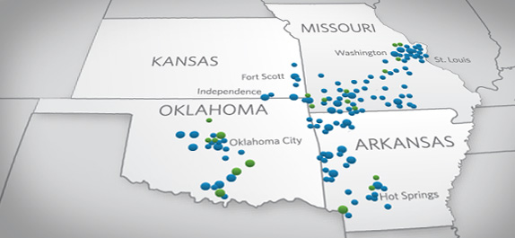
MERCY INTRANETS
31 hospitals and 300 clinics across the midwest (Arkansas, Kansas, Missouri and Oklahoma)
Each location developed and maintained their own intranet
Each intranet used its own technology and support structure

Slide 3
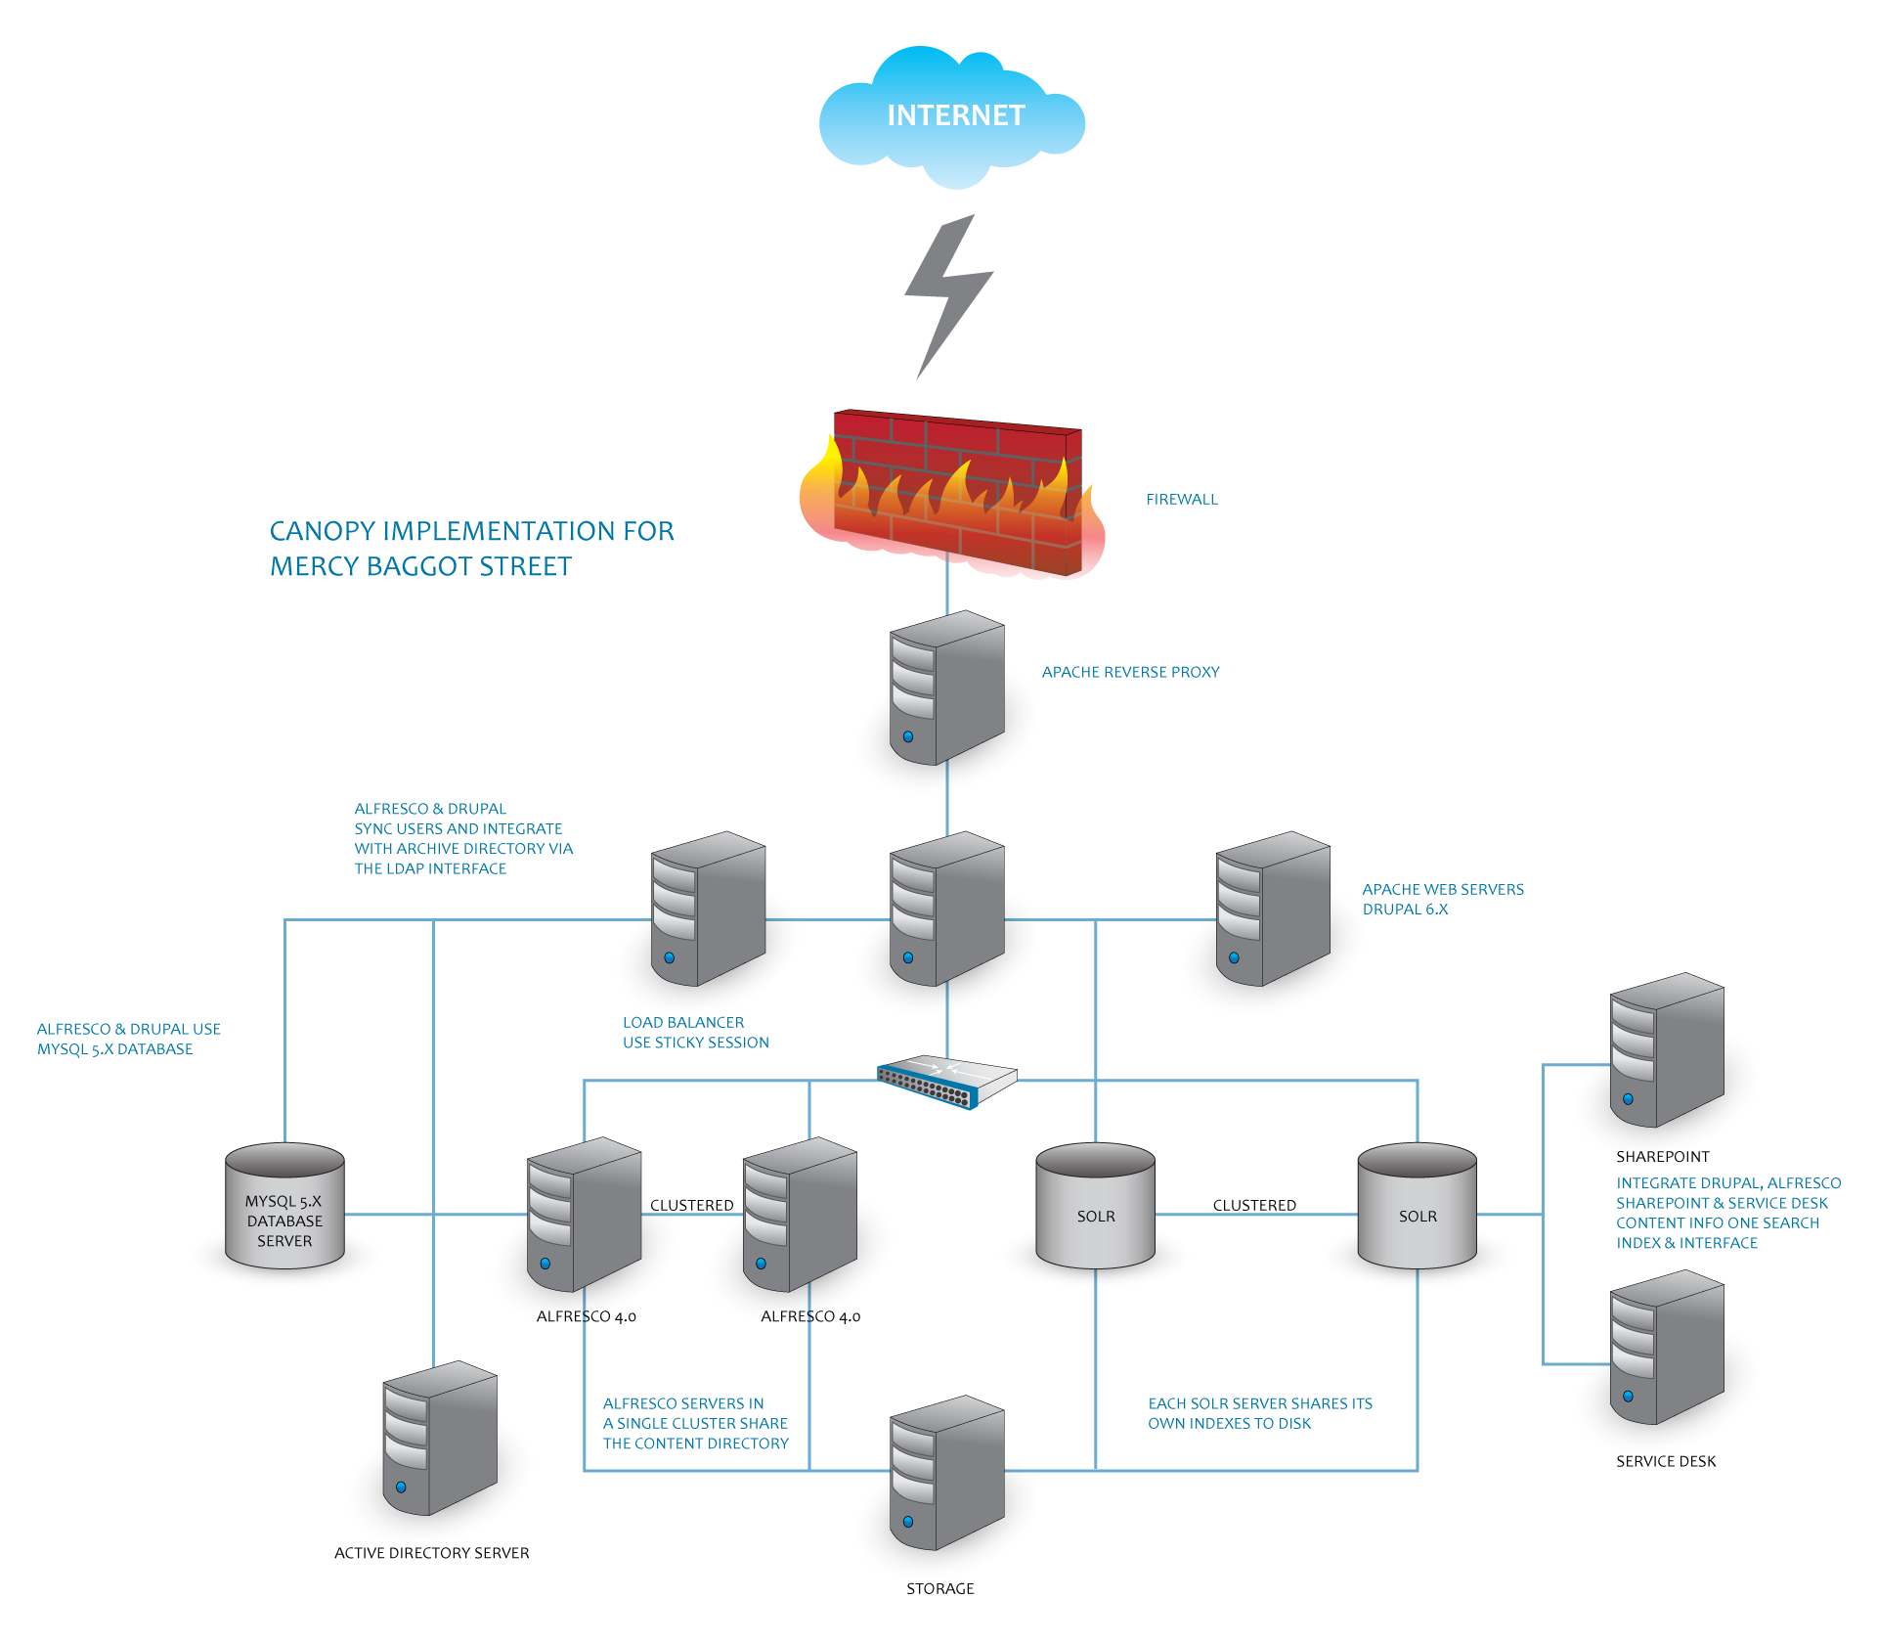
INTEGRATION POINTS
Notes:
Drupal - Alfresco Data Synchronization Integration
Drupal – Alfresco – CMIS - Apachesolr Document Search Integration
Document Upload from Alfresco to Drupal
Custom Workflow

